Slide 1
HITACHI CONFIDENTIAL
Virtual Clamping Force

Slide 2
HITACHI CONFIDENTIAL
Virtual method of determining the clamping force in a (smart) brake system
Progress meeting
BRBU
(Astemo)
28/11/2023
ACL
(European R&D)
Anthony Ohazulike
Henning Sauerland
Massimiliano Lenardi
Hitachi Europe R&D Centre France
anthony.ohazulike@hitachi-eu.com
Abdessamed Ramdane
Damian Janikowski
Advanced Engineering Brake Business Unit
abdessamed.ramdane@hitachiastemo.com

Slide 3
HITACHI CONFIDENTIAL
Recap on Virtual Temperature Sensor

Slide 4
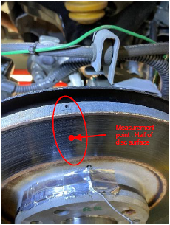
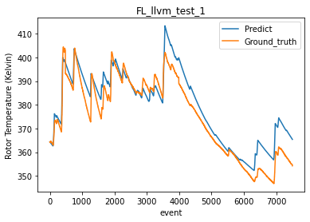
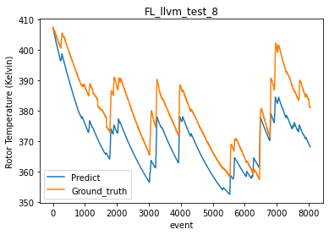
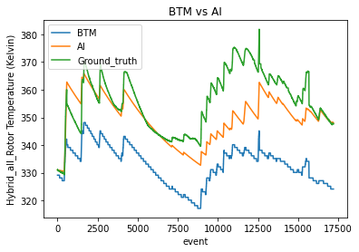
Results on virtual temperature sensor
HITACHI CONFIDENTIAL

Slide 5
HITACHI CONFIDENTIAL
Virtual Clamping Force Sensor for EMB

Slide 6
Schematic diagram of the EMB system.

Slide 7
HITACHI CONFIDENTIAL
Objective
Estimation of a (virtual) clamping force to be able to control the clamping of the brake accurately without force sensor.
Issue
Inaccurate target position estimation due to fixed mapping curve, which in reality, changes with many parameters.
Value
AI can be used as a digital force sensor, reducing the amount of force sensors, hence reducing cost. PIML* creates the possibility that even less data can be used, and that output tends to adapt to the mechanics of the brake system.
Target
Error range of +/- 500N or less
* Physics Informed Machine Learning

Slide 8
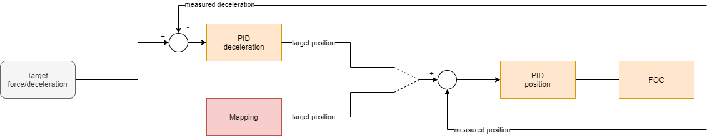
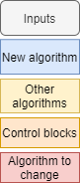
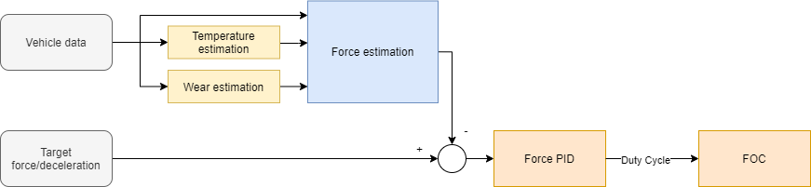
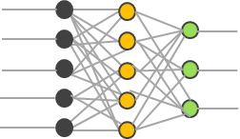
Issues and solution
HITACHI CONFIDENTIAL
Current solution
Either control via deceleration control loop or Mapping (Target force vs. Rotor position)
mapping
Clamping force
Clamping force
Piston position
Piston position
Issue
Inaccurate target position estimation due to fixed mapping curve which in reality changes with many parameters.
Proposed solution
Solution that is driven by Artificial Intelligence (AI) Machine Learning and physics.

Slide 9
Issues and solution
HITACHI CONFIDENTIAL
Benefits of the proposed solution
Solution is driven by Artificial Intelligence (AI) Machine Learning and physics
Able to understand complex relationship of brake system parameters
Force estimated based on many parameters for better accuracy
Eliminates one control loop (space for algorithm time execution improvement)
No need for physical temperature wear or force sensors
No similar solution exists in the market

Slide 10
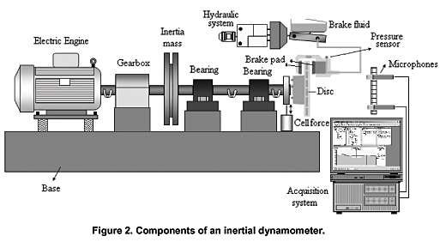

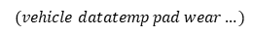
AI and Machine Learning (Data-driven) approach
HITACHI CONFIDENTIAL
Learning process
Feature selection
Relevant features
Data extraction
Learn the relationship
Implement
Input (experimental data + more features from mathematical relations)
Neural network or any other ML/AI algorithm
Output
Input
Pedal stroke/force
Current
Voltage
Speed
Disc Temperature
Pad/disc wear
Last Brake duration
Physic-based Clamping Force
…
Neural network or any other ML/AI algorithm
Pedal stroke/force
Speed
Current (I)
Voltage (V)
I x V
Disc temperature
Pad/disc wear
…
…
Learnt functions
$$f_{temp}(speed I V accel...)$$
Output
Clamping Force
Ground truth
Clamping Force
Ground truth
Clamping Force
Clamping force
Brake dynamo
Test car
$$(vehicle datatemp pad wear…)$$
AI-generated

Slide 11
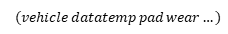
AI and Machine Learning (Data-driven) approach
HITACHI CONFIDENTIAL
Deployment/execution process
Temperature Estimation
Output
Data extraction
and Feed
Input (real time data + feature engineered data)
Trained Neural network or any other ML/AI algorithm
Output
Pedal stroke/force
Current (I)
Voltage (V)
I x V
Disc temperature
Pad/disc wear
…
…
Clamping Force
Clamping force
$$(vehicle datatemp pad wear…)$$

Slide 12
Remarks and Conclusion
Clamping Force Estimation
Results show very high accuracy for CF <= 10,000N.
Still more data would be needed for high CF.
AI could learn some of the “unexplainable” clamping force behavior, which cannot be correctly estimated by the mapping.
PIML improved Data-only driven models.
Deployment workflow shows a latency of about 0.11ms within the target on MABX.

Slide 13
Notes:
本日は有難うございました。

